Slide 1
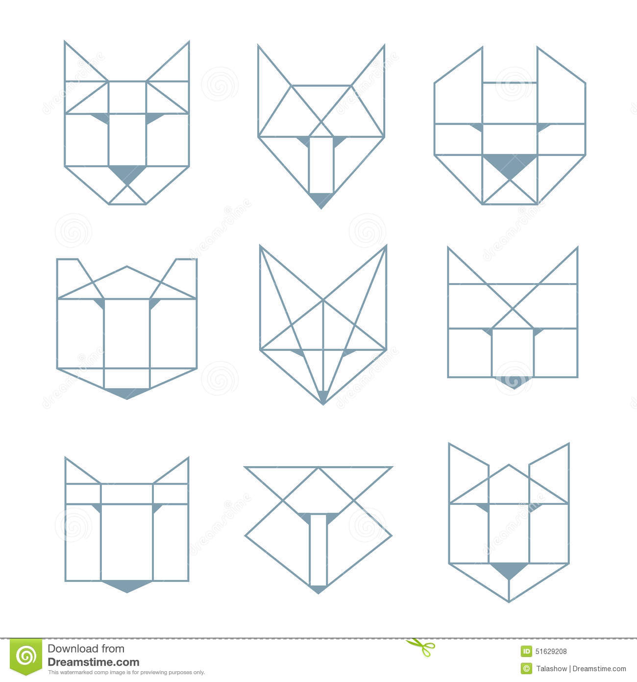

Slide 2
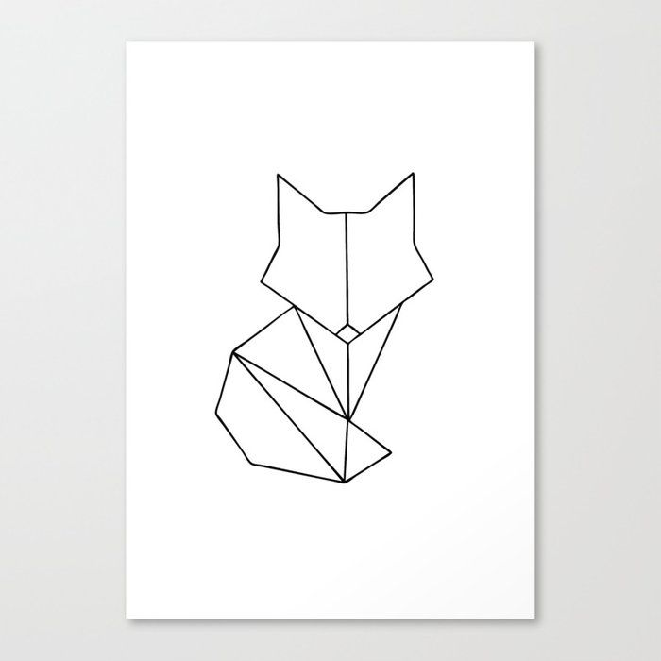

Slide 4


Slide 5
A
B

Slide 6
a
A
A’
b

Slide 7
d
A
B
C
a

